Slide 1
William Stallings
Data and Computer Communications
7th Edition
Chapter 5
Signal Encoding Techniques

Slide 2
Analog & Digital Data
Digital data is a source entity of which meaning has discrete values, such as the text or integers.
Analog data is a source entity of which meaning has continuous values, such as voice or video.

Slide 3
Analog & Digital Signal
Digital signal is a sequence of voltage pulses that can only be transmitted over certain wired media.
Analog signal is continuously varying electromagnetic wave that could be transmitted over a variety of wired and wireless media.

Slide 4
Analog & Digital Transmission
Digital transmission is a transmission system that is concerned about the content of data it transmits or receives. It can carry either digital data or analog data with either a digital signal or an analog signal.
Analog transmission is a transmission system that is not concerned about the content of data it transmits or receives. It can carry either analog data or digital data with an analog signal only.

Slide 5
Encoding Techniques (4 Combinations)
Digital data, digital signal
Analog data, digital signal
Digital data, analog signal
Analog data, analog signal
A digital transmission system can use each of the four combinations for its applications, but an analog transmission system can only use an analog signal to carry either digital data or analog data.

Slide 6
Digital Data, Digital Signal
Digital signal
  Discrete, discontinuous voltage pulses
  Each pulse is a signal element
  Binary data encoded into signal elements

Slide 7
Various Terms (1)
Unipolar
  All signal elements have same sign
Polar
  One logic state represented by positive voltage the other by negative voltage
Data rate
  Rate of data transmission in bits per second
Duration or length of a bit
  Time taken for transmitter to emit the bit

Slide 8
Terms (2)
Modulation rate
  Rate at which the signal level changes
  Measured in baud = signal elements per second
Mark and Space
  Binary 1 and Binary 0 respectively

Slide 9
Interpreting Signals
Need to know
  Timing of bits - when they start and end
  Signal levels
Factors affecting successful interpreting of signals
  Signal to noise ratio
  Data rate
  Bandwidth

Slide 10
Comparison of Encoding Schemes (1)
Signal Spectrum
  Lack of high frequencies reduces required bandwidth
  Concentrate power in the middle of the bandwidth
Clocking
  Synchronizing transmitter and receiver
  External clock
  Sync mechanism based on signal

Slide 11
Comparison of Encoding Schemes (2)
Error detection
  Can be built in to signal encoding
Signal interference and noise immunity
  Some codes are better than others
Cost and complexity
  Higher signal rate (& thus data rate) lead to higher costs
  Some codes require signal rate greater than data rate

Slide 12
Encoding Schemes
Nonreturn to Zero-Level (NRZ-L)
Nonreturn to Zero Inverted (NRZI)
Bipolar -AMI
Pseudoternary
Manchester
Differential Manchester
B8ZS
HDB3

Slide 13
Nonreturn to Zero-Level (NRZ-L)
Two different voltages for 0 and 1 bits
Voltage constant during bit interval
  no transition i.e. no return to zero voltage
e.g. Absence of voltage for zero, constant positive voltage for one
More often, negative voltage for one value and positive for the other
This is NRZ-L

Slide 14
Nonreturn to Zero Inverted
Nonreturn to zero inverted on ones
Constant voltage pulse for duration of bit
Data encoded as presence or absence of signal transition at beginning of bit time
Transition (low to high or high to low) denotes a binary 1
No transition denotes binary 0
An example of differential Encoding

Slide 15
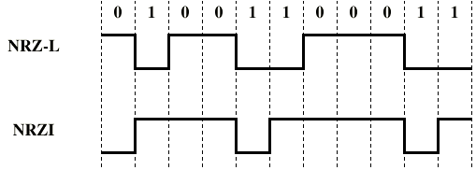
NRZ

Slide 16
Differential Encoding
Data represented by changes rather than levels
More reliable detection of transition rather than level
In complex transmission layouts it is easy to lose sense of polarity

Slide 17
NRZ pros and cons
Pros
  Easy to engineer
  Make good use of bandwidth
Cons
  Lack of synchronization capability
Used for magnetic recording
Not often used for signal transmission

Slide 18
Multilevel Binary
Use more than two levels
Bipolar-AMI (Alternate Mark Inversion)
  zero represented by no line signal
  one represented by positive or negative pulse
  one pulses alternate in polarity
  No loss of sync if a long string of ones (zeros still a problem)
  No net dc component
  Lower bandwidth
  Easy error detection
  Example: 01001100011

Slide 19
Pseudoternary
Opposite to Bipolar-AMI
One represented by absence of line signal
Zero represented by alternating positive and negative
No advantage or disadvantage over bipolar-AMI
Example:01001100011

Slide 20
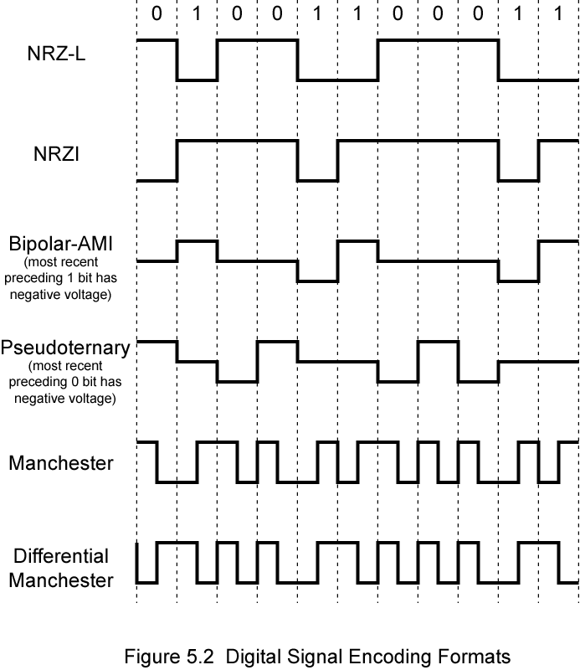
Bipolar-AMI and Pseudoternary

Slide 21
Trade Off for Multilevel Binary
Not as efficient as NRZ
  Each signal element only represents one bit
  In a 3 level system could represent log₂3 = 1.58 bits
  Receiver must distinguish between three levels
  (+A, -A, 0)
  Requires approx. 3dB more signal power for same probability of bit error

Slide 22
Biphase
Manchester
  Transition in middle of each bit period
  Transition serves as clock and data
  Low to high represents one
  High to low represents zero
  Used by IEEE 802.3
Differential Manchester
  Middle bit transition is clocking only
  Transition at start of a bit period represents zero
  No transition at start of a bit period represents one
  Note: this is a differential encoding scheme
  Used by IEEE 802.5 with Twisted Pair

Slide 23
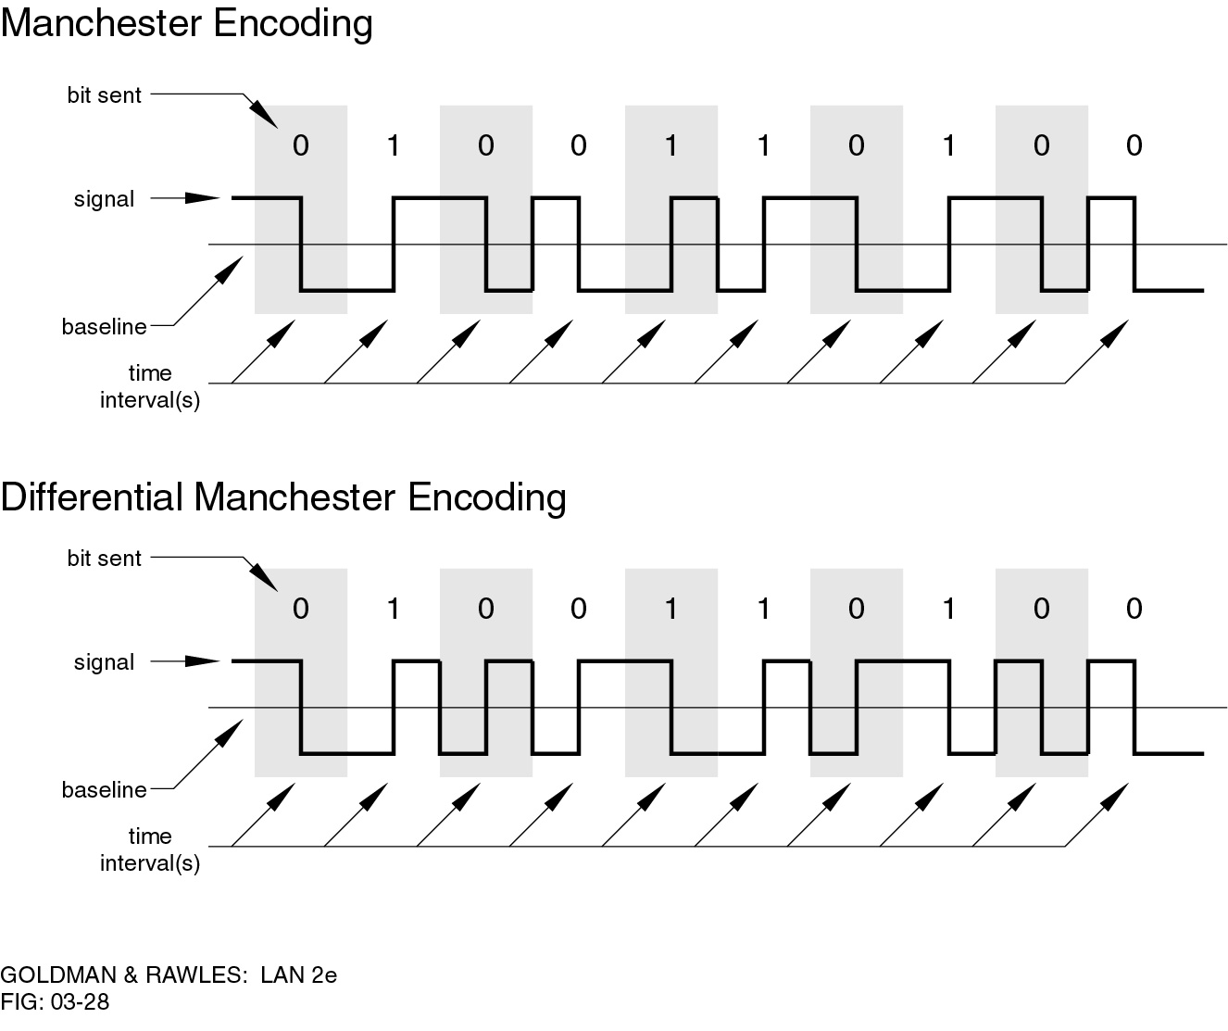
Manchester Encoding

Slide 24
Differential Manchester Encoding

Slide 25
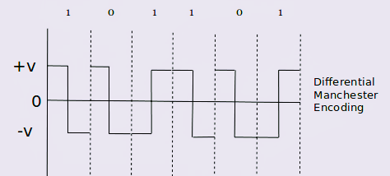
Differential Manchester Encoding
The transition at the middle bit is used only for Synchronization.
At 0 Transition will be there at the beginning of the Bit interval.
At 1 Transition will be absent at the beginning of the Bit interval.
Used in 802.5 with Twisted Pair.

Slide 26
Biphase Pros and Cons
Con
  At least one transition per bit time and possibly two
  Maximum modulation rate is twice NRZ
  Requires more bandwidth
Pros
  Synchronization on mid bit transition (self clocking)
  No dc component
  Error detection
    Absence of expected transition

Slide 27
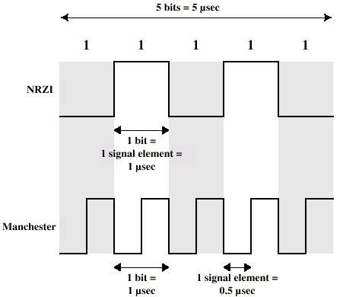
Modulation Rate

Slide 28
Scrambling
Use scrambling to replace sequences that would produce constant voltage
Filling sequence
  Must produce enough transitions to sync
  Must be recognized by receiver and replace with original
  Same length as original
No dc component
No long sequences of zero level line signal
No reduction in data rate
Error detection capability

Slide 29
B8ZS
Bipolar With 8 Zeros Substitution
Based on bipolar-AMI
If octet of all zeros and last voltage pulse preceding was positive encode as 000+-0-+
If octet of all zeros and last voltage pulse preceding was negative encode as 000-+0+-
Causes two violations of AMI code
Unlikely to occur as a result of noise
Receiver detects and interprets as octet of all zeros

Slide 30
HDB3
High Density Bipolar 3 Zeros
Based on bipolar-AMI
String of four zeros replaced with one or two pulses

Slide 31
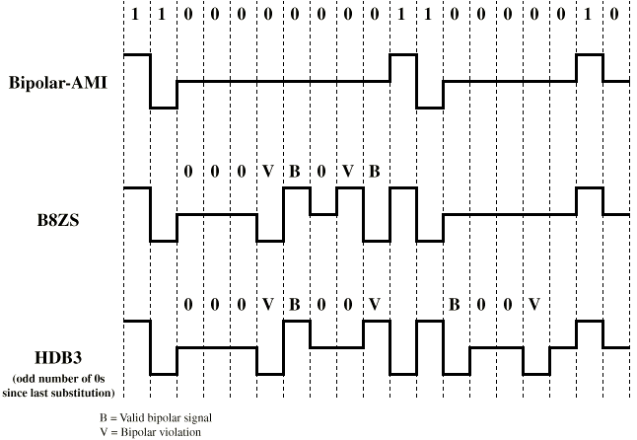
B8ZS and HDB3

